Slide 1
פרק 8 - Main Memory

Slide 2
Chapter 8: Memory Management
Background
Swapping
Contiguous Memory Allocation
Paging
Structure of the Page Table
Segmentation

Slide 3
רקע
חשיבות:
הזיכרון הראשי (main memory), הרגיסטרים וה- cache הם אמצעי האחסון (storage) היחידים אליהם יכול לגשת המעבד
על-מנת שנוכל להריץ תכנית (המאוחסנת בדיסק) יש ליצור ממנה תהליך בזיכרון
אתגרים:
ניהול הזיכרון (מי מאוחסן איפה בכל רגע, הקצאת זיכרון לתהליכים וכו')
הגנה על זיכרון של תהליכים מפני גישה לא מורשית

Slide 4
Logical vs. Physical Address Space
The concept of a logical address space that is bound to a separate physical address space is central to proper memory management
Logical address – generated by the CPU; also referred to as virtual address
Physical address – address seen by the memory unit

Slide 5
Binding of Instructions and Data to Memory
צימוד ה- instructions וה- data לכתובות זיכרון (binding instructions and data to memory addresses) יכול לקרות בכל אחד משלושת השלבים הבאים:
בזמן הקימפול compile time)):
נקבל absolute code (מתאים למקרים שבהם ידוע לנו מראש המיקום בזיכרון של התהליך)
מחייב קומפילציה מחדש במידה ורוצים להריץ במיקום אחר בזיכרון
בזמן ה- Loading:
מחייב יצירה של relocatable code
בזמן ה- execution:
הצימוד יתבצע בזמן ה- runtime.
מאפשר "הזזה" של התהליך בזיכרון בזמן הריצה

Slide 6
Logical vs. Physical Address Space
Logical and physical addresses are the same in compile-time and load-time address-binding schemes
Logical (virtual) and physical addresses differ in execution-time address-binding scheme

Slide 7
Memory-Management Unit (MMU)
Hardware device that maps virtual to physical address
In MMU scheme, the value in the relocation register is added to every address generated by a user process at the time it is sent to memory
The user program deals with logical addresses; it never sees the real physical addresses

Slide 8
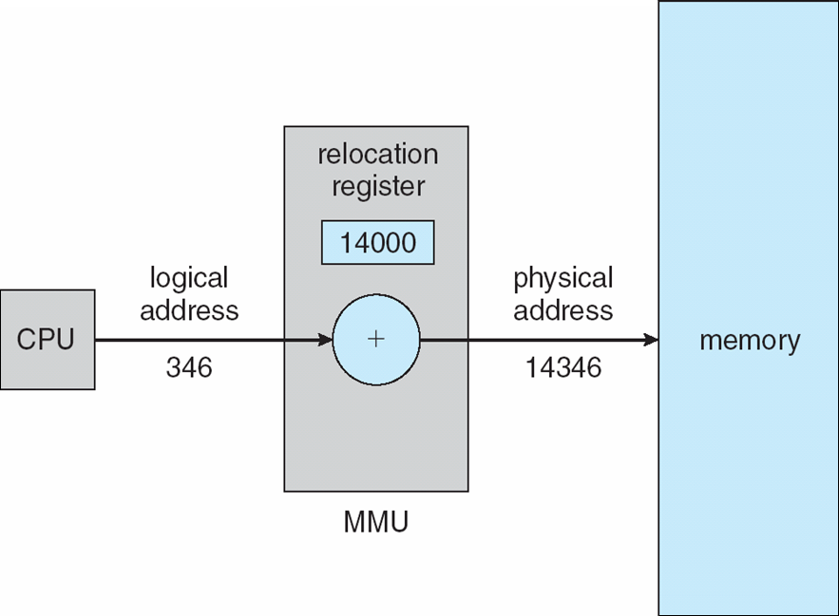
Dynamic relocation using a relocation register

Slide 9
Swapping
A process can be swapped temporarily out of memory to a backing store, and then brought back into memory for continued execution
Backing store – fast disk large enough to accommodate copies of all memory images for all users; must provide direct access to these memory images
Roll out, roll in – swapping variant used for priority-based scheduling algorithms; lower-priority process is swapped out so higher-priority process can be loaded and executed
Major part of swap time is transfer time; total transfer time is directly proportional to the amount of memory swapped
Modified versions of swapping are found on many systems (i.e., UNIX, Linux, and Windows)

Slide 10
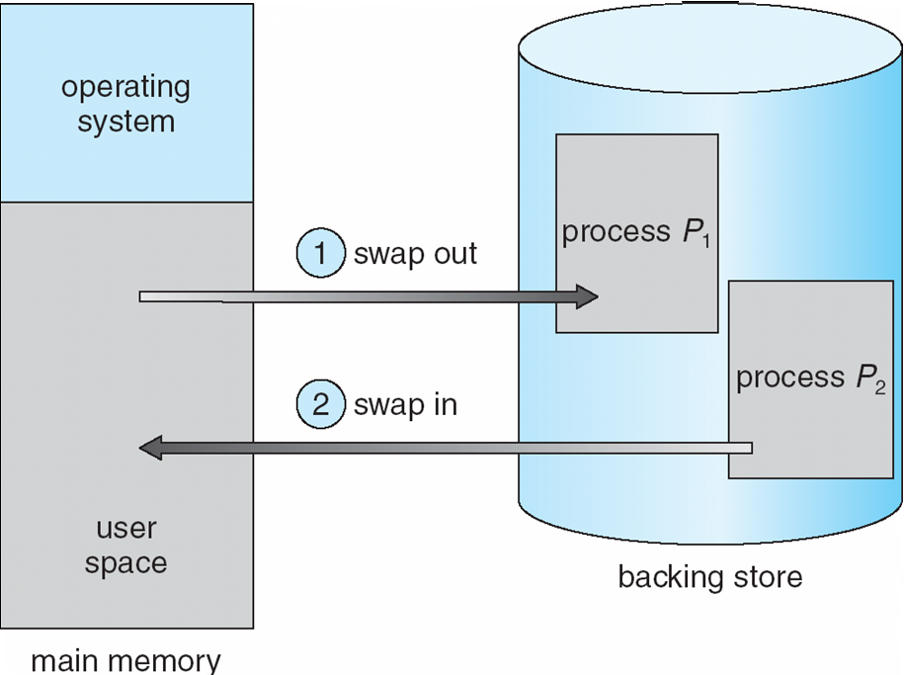
Schematic View of Swapping

Slide 11
Contiguous Allocation
Main memory usually divided into two partitions:
Resident operating system, usually held in low memory with interrupt vector
User processes then held in high memory
Relocation registers used to protect user processes from each other, and from changing operating-system code and data
Base register contains value of smallest physical address
Limit register contains range of logical addresses – each logical address must be less than the limit register
MMU maps logical address dynamically

Slide 12
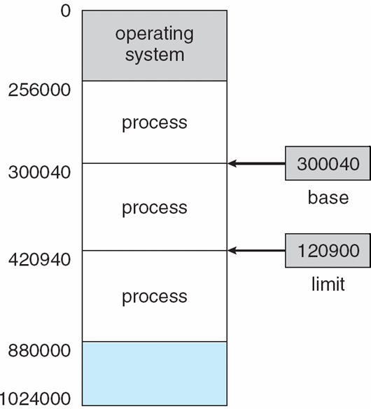
Base and Limit Registers
A pair of base and limit registers define the logical address space

Slide 13

Hardware Support for Relocation and Limit Registers

Slide 14
Contiguous Allocation (Cont)
Multiple-partition allocation
Hole – block of available memory; holes of various size are scattered throughout memory
When a process arrives, it is allocated memory from a hole large enough to accommodate it
Operating system maintains information about: a) allocated partitions b) free partitions (hole)
OS
OS
OS
OS
process 5
process 5
process 5
process 5
process 9
process 9
process 8
process 10
process 2
process 2
process 2
process 2

Slide 15
Dynamic Storage-Allocation Problem
How to satisfy a request from a list of free holes?
First-fit: Allocate the first hole that is big enough
Best-fit: Allocate the smallest hole that is big enough; must search entire list, unless ordered by size
Produces the smallest leftover hole
Worst-fit: Allocate the largest hole; must also search entire list
Produces the largest leftover hole
First-fit and best-fit better than worst-fit in terms of speed and storage utilization

Slide 16
Fragmentation
External Fragmentation – total memory space exists to satisfy a request, but it is not contiguous
Internal Fragmentation – allocated memory may be slightly larger than requested memory; this size difference is memory internal to a partition, but not being used
Reduce external fragmentation by compaction
Shuffle memory contents to place all free memory together in one large block
Compaction is possible only if relocation is dynamic, and is done at execution time
I/O problem
Latch job in memory while it is involved in I/O
Do I/O only into OS buffers

Slide 17
Paging
Logical address space of a process can be noncontiguous; process is allocated physical memory whenever the latter is available
Divide physical memory into fixed-sized blocks called frames (size is power of 2, between 512 bytes and 8,192 bytes)
Divide logical memory into blocks of same size called pages
Keep track of all free frames
To run a program of size n pages, need to find n free frames and load program
Set up a page table to translate logical to physical addresses
Internal fragmentation

Slide 18
Address Translation Scheme
Address generated by CPU is divided into:
Page number (p) – used as an index into a page table which contains base address of each page in physical memory
Page offset (d) – combined with base address to define the physical memory address that is sent to the memory unit
For given logical address space 2^{m} and page size 2^{n}
page number
page offset
p
d
m - n
n

Slide 19
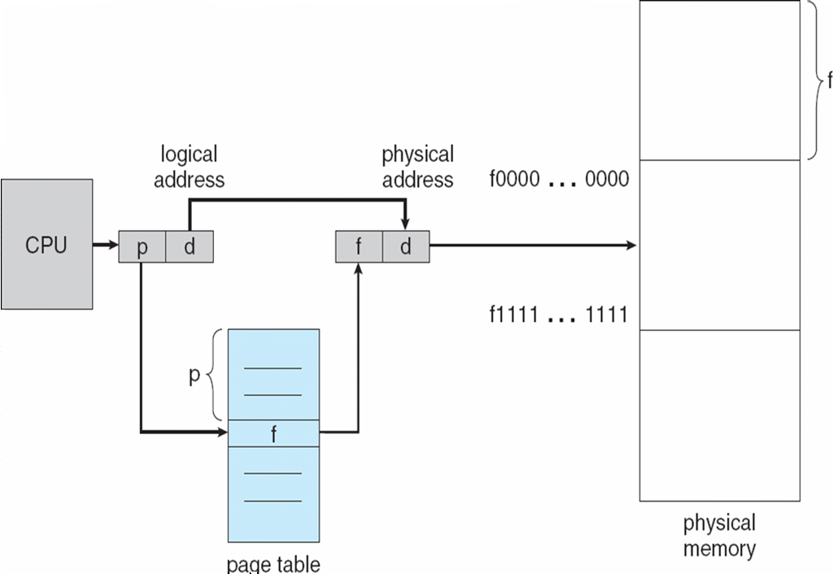
Paging Hardware

Slide 20

Paging Model of Logical and Physical Memory

Slide 21

Paging Example
32-byte memory and 4-byte pages

Slide 22

Free Frames
Before allocation
After allocation

Slide 23
Implementation of Page Table
Page table is kept in main memory
Page-table base register (PTBR) points to the page table
Page-table length register (PRLR) indicates size of the page table
In this scheme every data/instruction access requires two memory accesses. One for the page table and one for the data/instruction.
The two memory access problem can be solved by the use of a special fast-lookup hardware cache called associative memory or translation look-aside buffers (TLBs)

Slide 24
Associative Memory
Associative memory – parallel search
Address translation (p, d)
If p is in associative register, get frame # out
Otherwise get frame # from page table in memory
Page #
Frame #

Slide 25

Paging Hardware With TLB

Slide 26
Effective Access Time
Associative Lookup = ε time unit
Assume memory cycle time is 1 microsecond
Hit ratio – percentage of times that a page number is found in the associative registers; ratio related to number of associative registers
Hit ratio = α
Effective Access Time (EAT)
EAT = (1 + ε) α + (2 + ε)(1 – α)
= 2 + ε – α
And if memory cycle is 2:
EAT = (2 + ε) α + (4 + ε)(1 – α)
= 4 + ε – 2α

Slide 27
Memory Protection
Memory protection implemented by associating protection bit with each frame
Valid-invalid bit attached to each entry in the page table:
“valid” indicates that the associated page is in the process’ logical address space, and is thus a legal page
“invalid” indicates that the page is not in the process’ logical address space

Slide 28

Valid (v) or Invalid (i) Bit In A Page Table

Slide 29
Shared Pages
Shared code
One copy of read-only (reentrant) code shared among processes (i.e., text editors, compilers, window systems).
Shared code must appear in same location in the logical address space of all processes
Private code and data
Each process keeps a separate copy of the code and data
The pages for the private code and data can appear anywhere in the logical address space

Slide 30
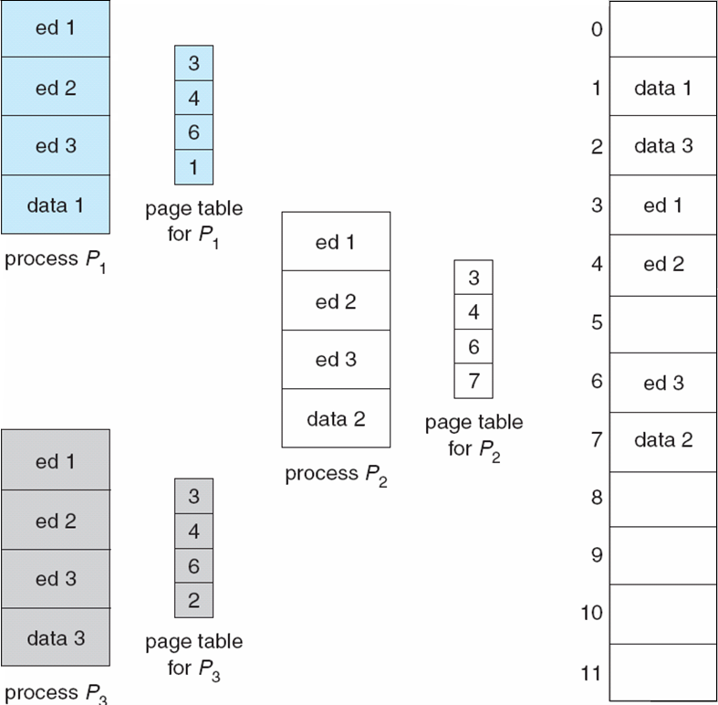
Shared Pages Example

Slide 31
Structure of the Page Table
Hierarchical Paging
Hashed Page Tables
Inverted Page Tables

Slide 32
Hierarchical Page Tables
Break up the logical address space into multiple page tables
A simple technique is a two-level page table

Slide 33
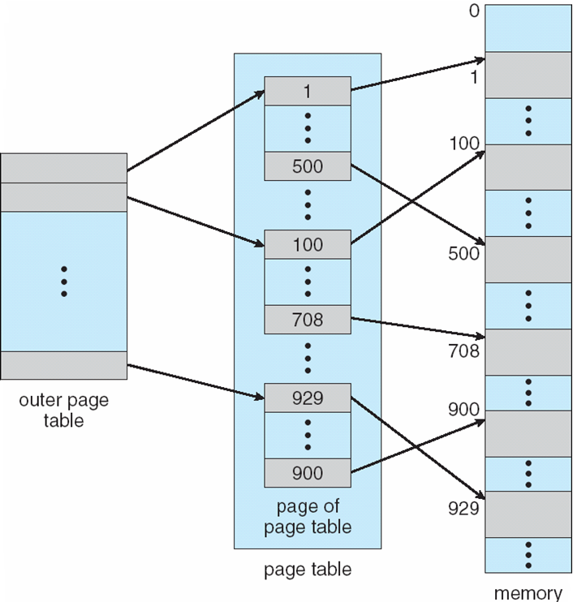
Two-Level Page-Table Scheme

Slide 34
Two-Level Paging Example
A logical address (on 32-bit machine with 1K page size) is divided into:
a page number consisting of 22 bits
a page offset consisting of 10 bits
Since the page table is paged, the page number is further divided into:
a 12-bit page number
a 10-bit page offset
Thus, a logical address is as follows: where p_{i} is an index into the outer page table, and p₂ is the displacement within the page of the outer page table
page number
page offset
p_{i}
p₂
d
12
10
10

Slide 35

Address-Translation Scheme

Slide 36


Three-level Paging Scheme

Slide 37

Hashed Page Tables
Common in address spaces > 32 bits
The virtual page number is hashed into a page table
This page table contains a chain of elements hashing to the same location
Virtual page numbers are compared in this chain searching for a match
If a match is found, the corresponding physical frame is extracted

Slide 38

Inverted Page Table
One entry for each real page of memory
Entry consists of the virtual address of the page stored in that real memory location, with information about the process that owns that page
Decreases memory needed to store each page table, but increases time needed to search the table when a page reference occurs
Use hash table to limit the search to one — or at most a few — page-table entries

Slide 39
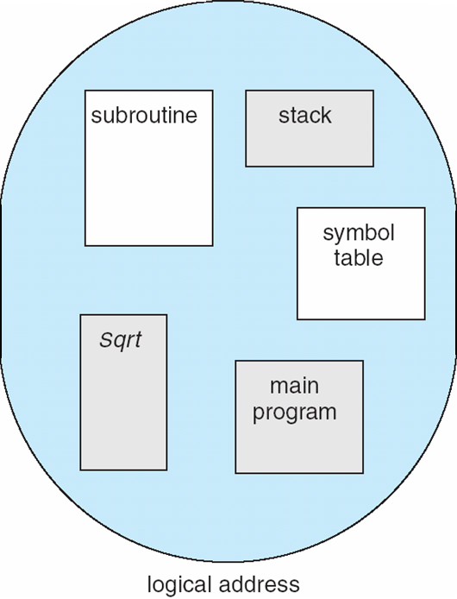
Segmentation
Memory-management scheme that supports user view of memory
A program is a collection of segments
A segment is a logical unit such as:
main program
procedure
function
method
object
local variables, global variables
common block
stack
symbol table
arrays

Slide 40
Logical View of Segmentation
1
1
4
2
3
4
2
3
user space
physical memory space

Slide 41
Segmentation Architecture
Logical address consists of a two tuple:
<segment-number, offset>,
Segment table – maps two-dimensional physical addresses; each table entry has:
base – contains the starting physical address where the segments reside in memory
limit – specifies the length of the segment
Segment-table base register (STBR) points to the segment table’s location in memory
Segment-table length register (STLR) indicates number of segments used by a program;
segment number s is legal if s < STLR

Slide 42
Segmentation Architecture (Cont.)
Protection
With each entry in segment table associate:
validation bit = 0 ⇒ illegal segment
read/write/execute privileges
Protection bits associated with segments; code sharing occurs at segment level
Since segments vary in length, memory allocation is a dynamic storage-allocation problem
A segmentation example is shown in the following diagram

Slide 43
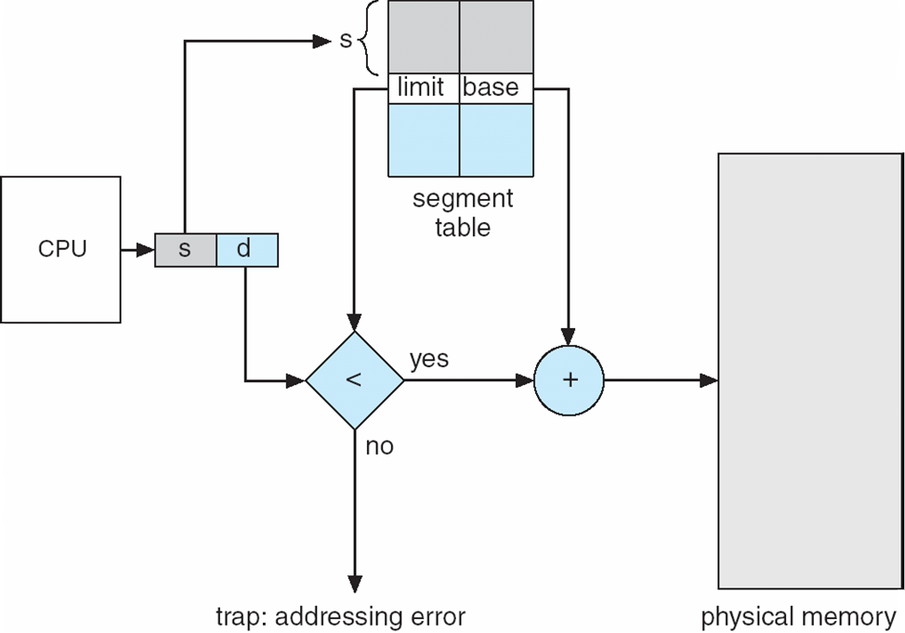
Segmentation Hardware

Slide 44
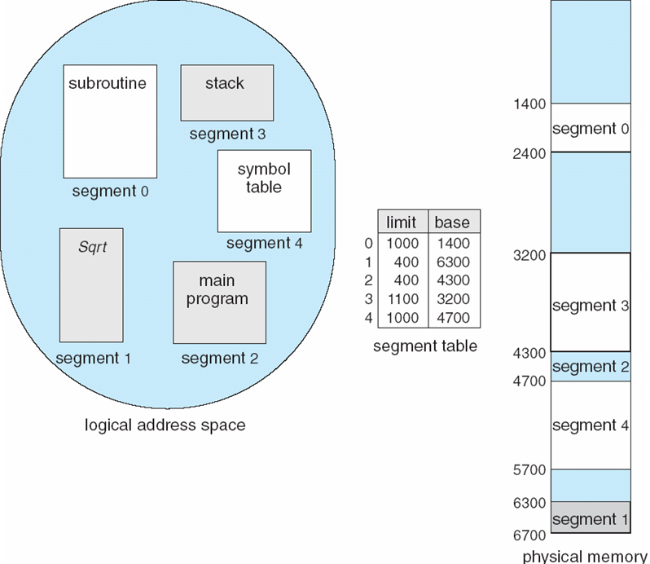
Example of Segmentation

Slide 45
Segmentation Architecture (Cont.)
Relocation.
dynamic
by segment table
Sharing.
shared segments
same segment number
Allocation.
first fit/best fit
external fragmentation

Slide 46
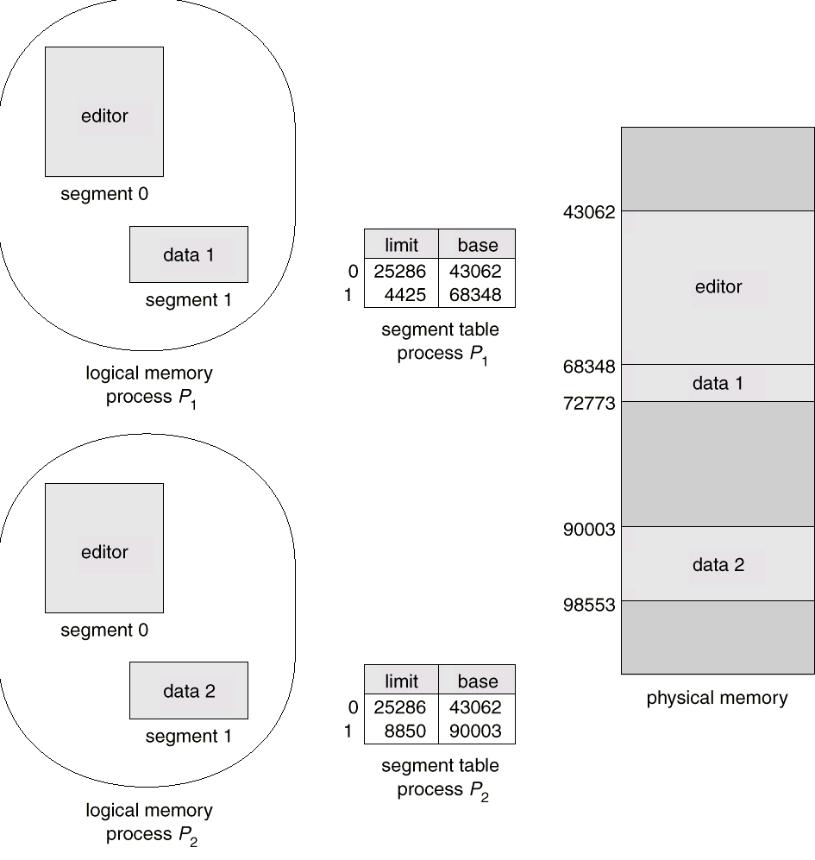
Sharing of Segments

Slide 47
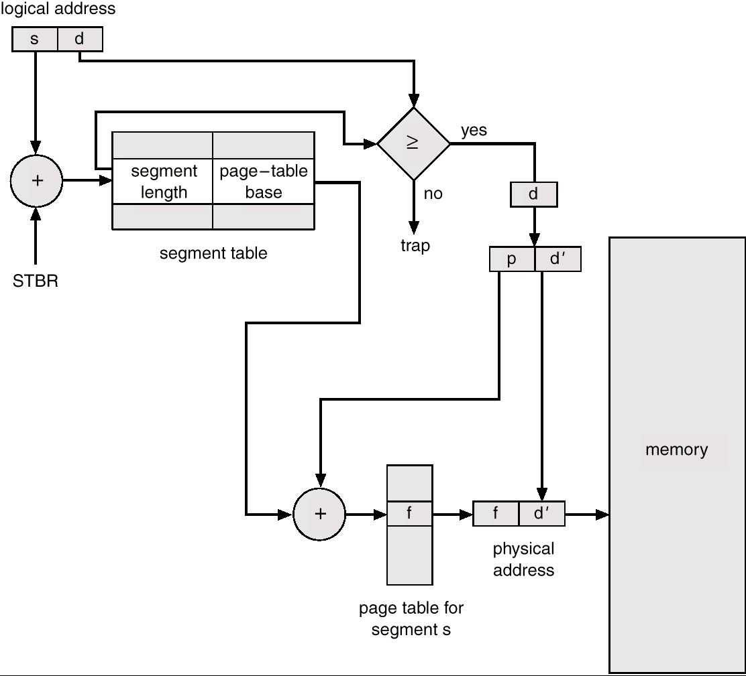
Segmentation with Paging – MULTICS
The MULTICS system solved problems of external fragmentation and lengthy search times by paging the segments
Solution differs from pure segmentation in that the segment-table entry contains not the base address of the segment, but rather the base address of a page table for this segment

